Slide 1
Business Analytics
Topic: Decision Analysis (Module – V)
M.Tech: Semester 2
(Open Elective)
By:
Prof. G.Apparao
Department of CSE,GIT, GITAM,Visakhapatnam

Slide 2
Decision Analysis
Contents
Defintion
Basic concepts
Various methods
Apply methods in simple problem solving

Slide 3
Decision Analysis
What Is Decision Analysis (DA)
A method for reducing uncertainity in the decision making process through data analysis
It provides a rational process for making decisions that is (usually) far better than random selection
Easy to update if conditions change

Slide 4
Decision Analysis
Decision analysis is a systematic, quantitative, and visual approach to making strategic business decisions.
Decision analysis uses a variety of tools and also incorporates aspects of psychology, management techniques, and economics.
Risk, capital investments, and strategic business decisions are areas where decision analysis can be applied.
Decision trees and influence diagrams are visual representations that help in the analysis process.
Graphical representation of alternatives and possible solutions, as well as challenges and uncertainties, can be created on a decision tree or influence diagram. More sophisticated computer models have also been developed to aid in the decision-analysis process.

Slide 5
Decision Analysis
What are the components of decision analysis?
Probabilities and outcome values: What are they and where do they come from? The basic components to a successful decision analysis are reliable probabilities and outcome values. A probability is a quantitative estimate of the chance or likelihood that a given outcome will occur.
Where is decision analysis used?
Decision analysis is used by major corporations to make multibillion-dollar capital investments and can be used to make more complex but personal decisions like planning retirement or planning a vacation

Slide 6
Decision Analysis
Why is decision analysis important?
Decision analysis is a formalized approach to making optimal choices under conditions of uncertainty. It allows the user to enter costs, probabilities, and health-related quality of life values among other inputs of interest, and then calculates probabilistically weighted means of these outcome measures.
How do you analyze? Critical reading:
decision-making process steps
Identify the decision. To make a decision, you must first identify the problem you need to solve or the question you need to answer. Gather relevant information. Identify the alternatives. ...
Weigh the evidence.Choose among alternatives. ...
Take action. Review your decision.

Slide 7
Decision Analysis
How do you analyze a decision
To improve your data analysis skills and simplify your decisions, execute these five steps in your data analysis process:
Step 1: Define Your Questions
Step 2: Set Clear Measurement Priorities
Step 3: Collect Data
Step 4: Analyze Data
Step 5: Interpret Results

Slide 8
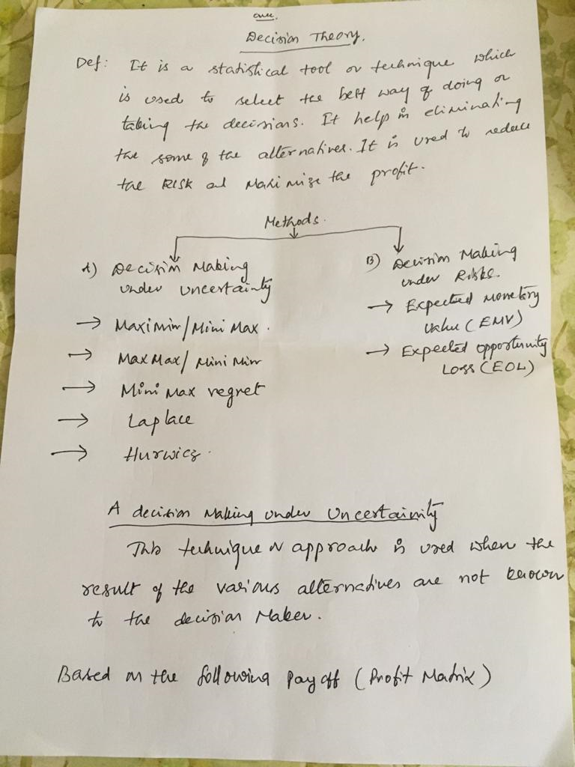
Methods of Decision Analysis

Slide 9
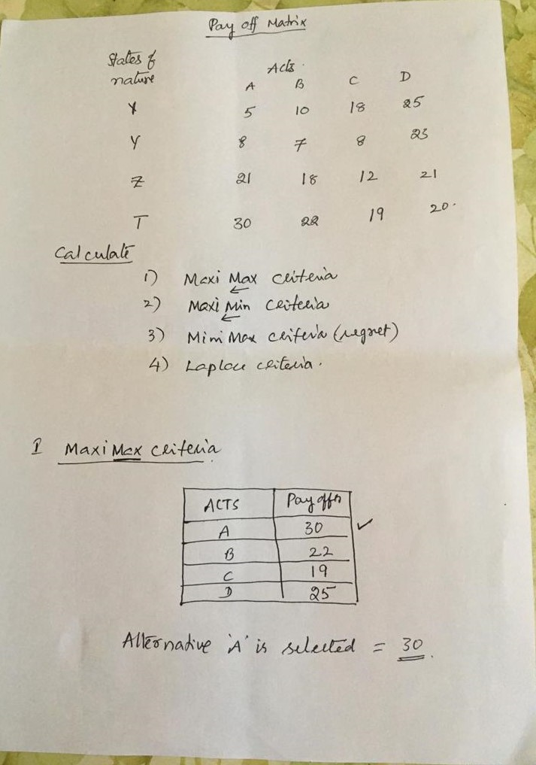
Example Problem

Slide 10
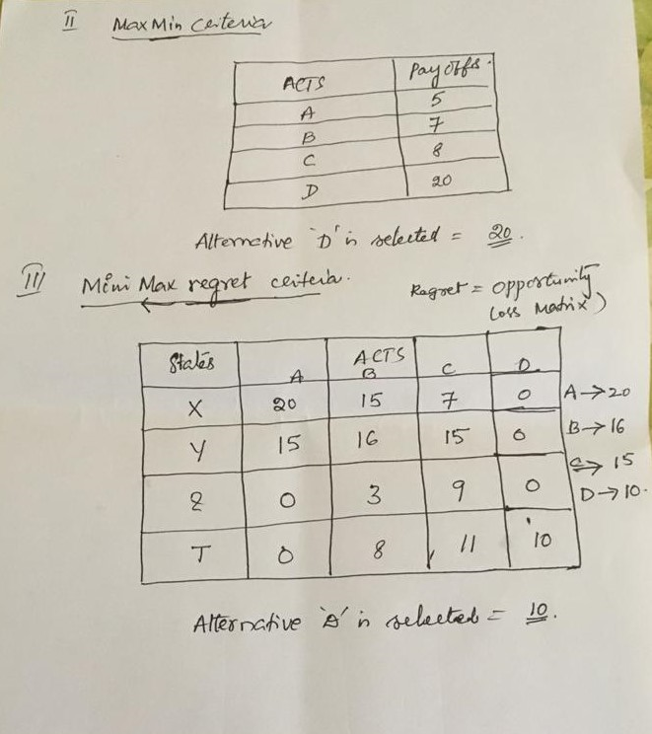

Slide 11
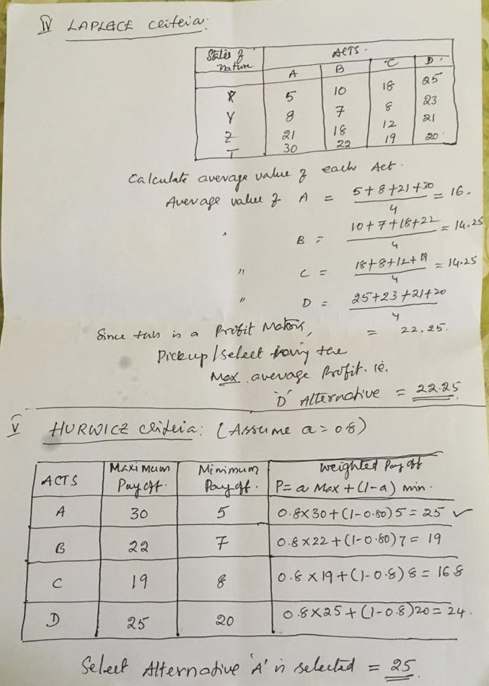

Slide 12
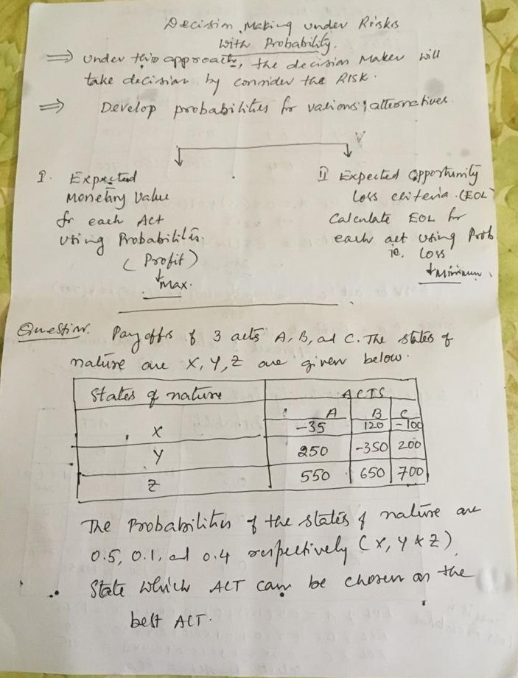

Slide 13


Slide 14
THANK YOU
ANY QUERIES?
Contact:agidutur@gitam.edu

